Slide 1
galvo
Illumination
Light-sheet generation
Detection
561 nm
515 nm
491 nm
445 nm
405 nm
f 200
f 50
f 140
f 350
v
f 100
Camera
f 200
f 180
DMM
LP 552
PBS
LP 503
filter
LP 466
f 350
f 150
f 100
LP 427
f 150
LM
f 50
AOTF
I1
I2
galvo
f 200

Slide 2
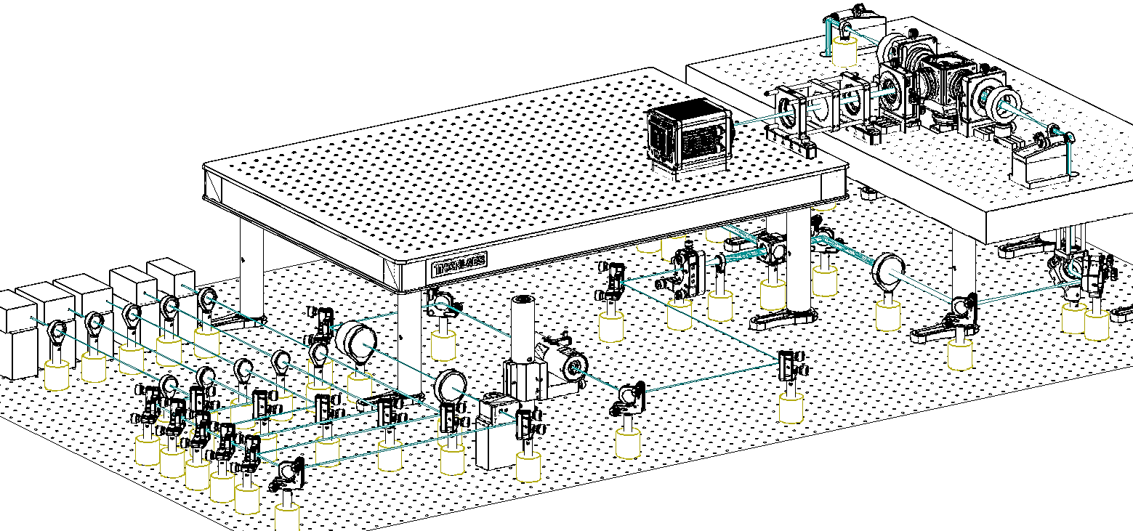

Slide 3
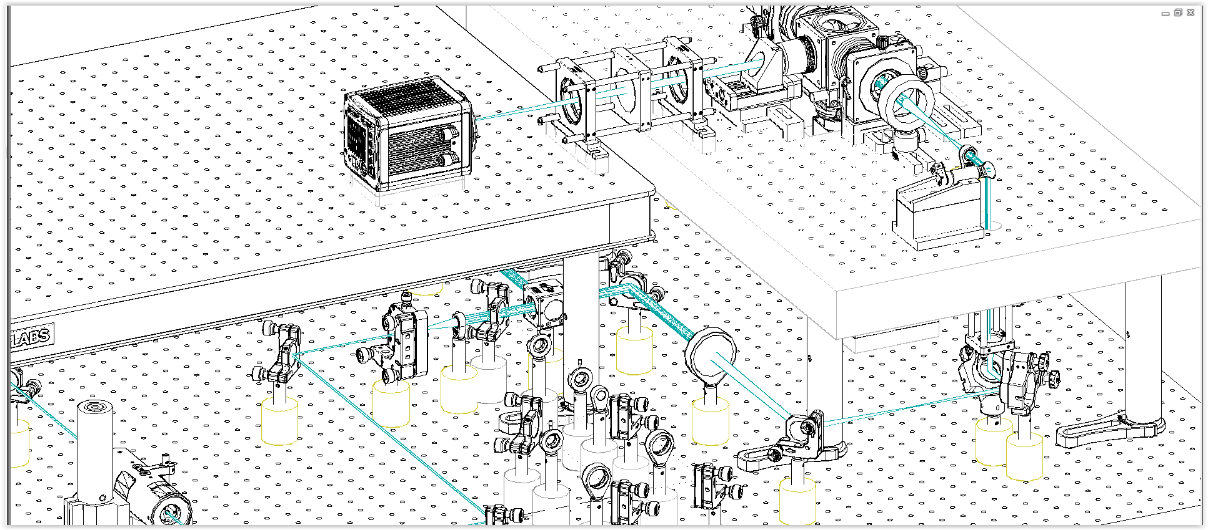

Slide 4
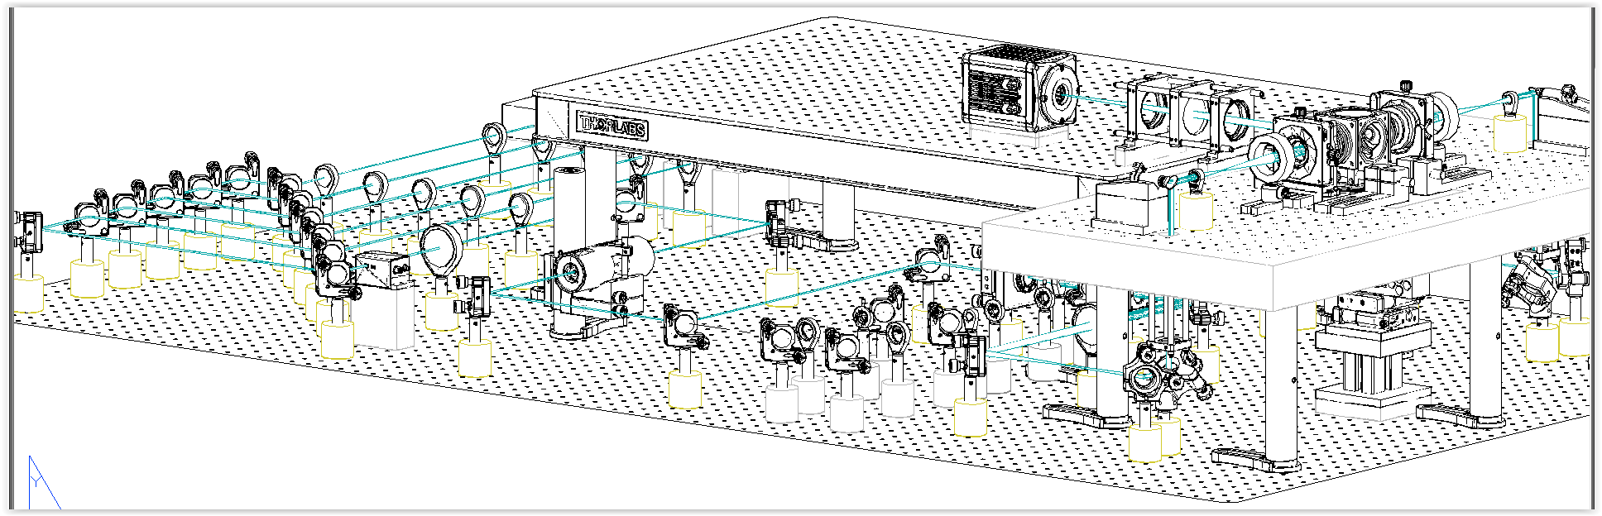

Slide 5
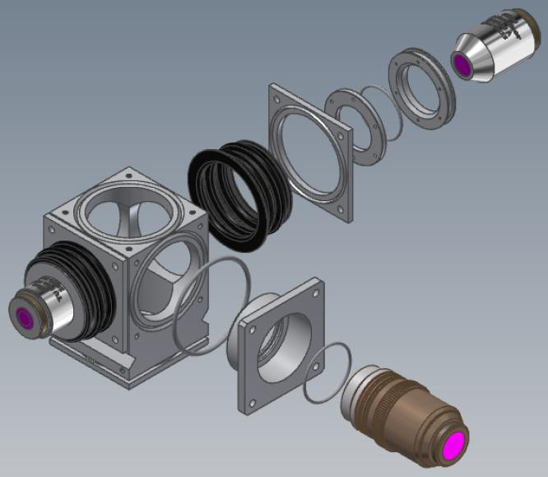
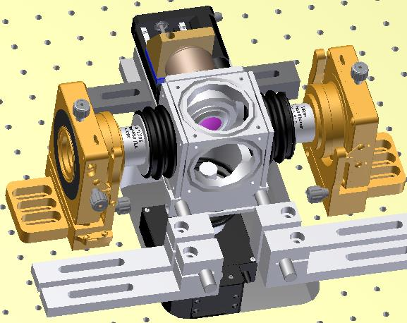
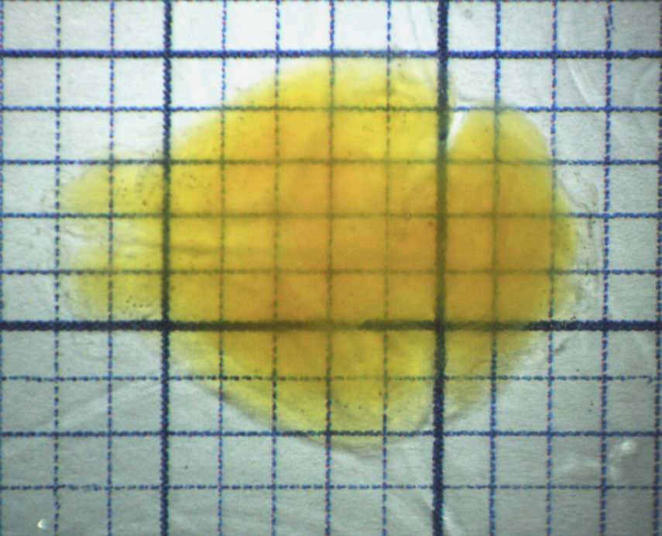
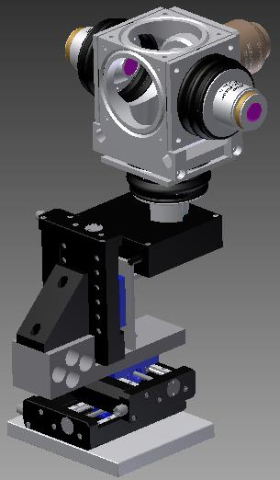
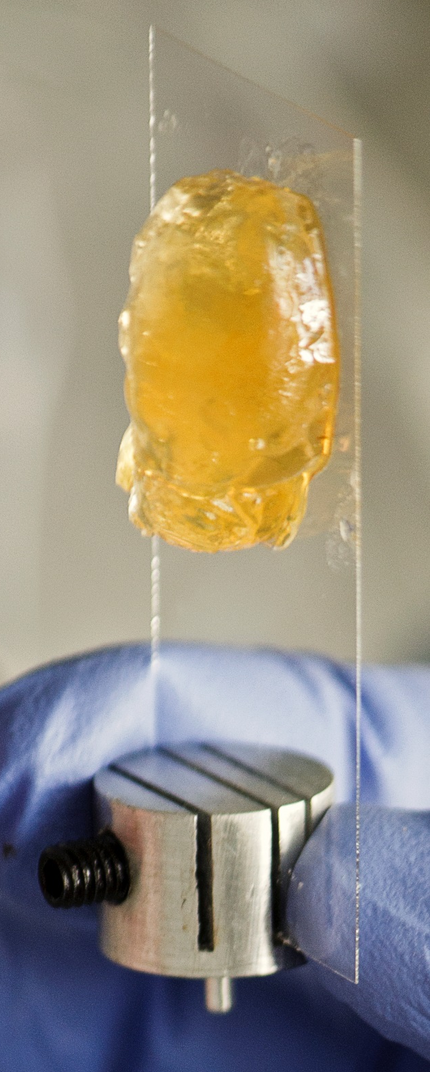
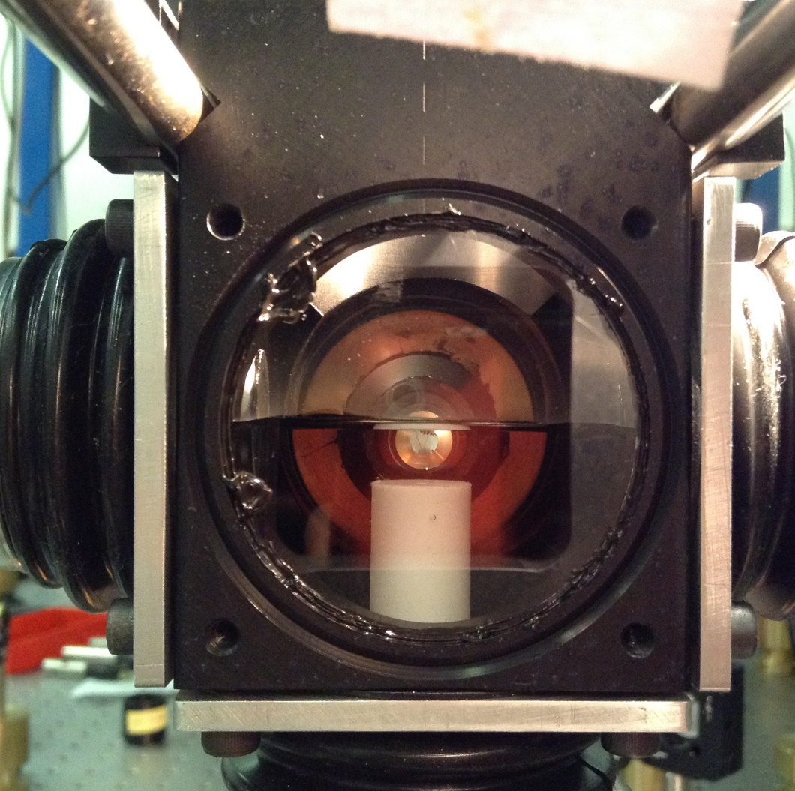
z
A
B
D
E
x
C

Slide 6
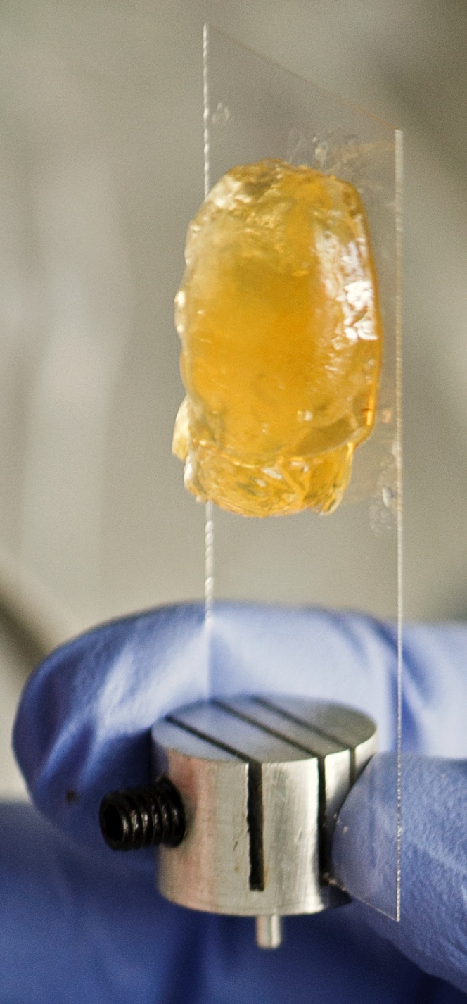

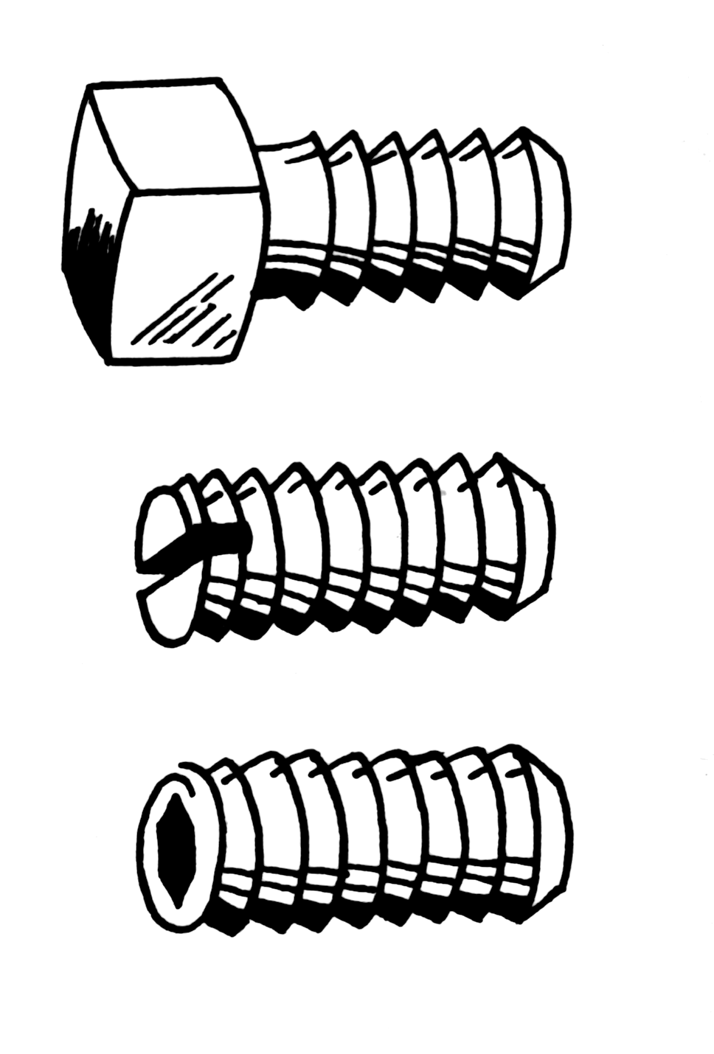
A
z
B
D
E
x
C

Slide 7
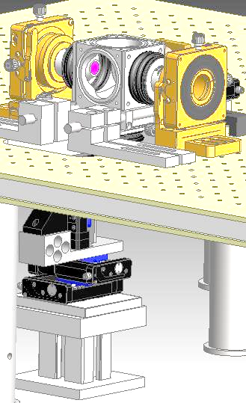
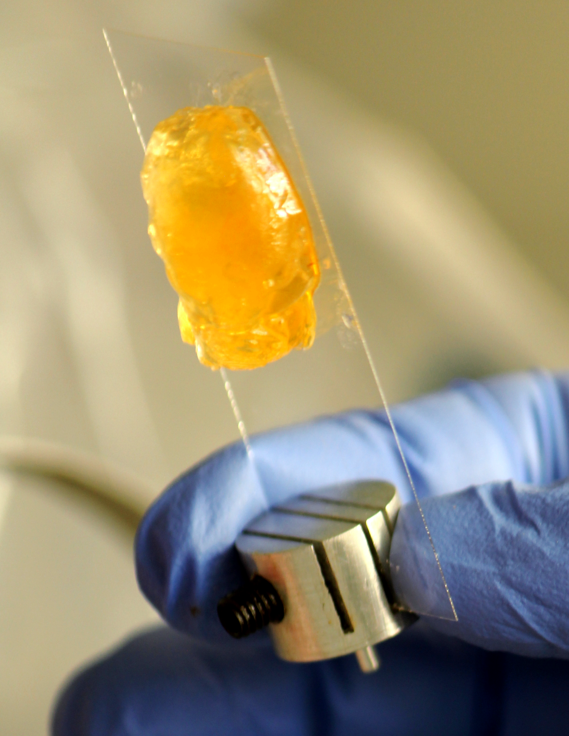
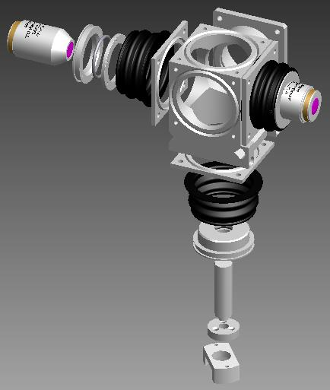

Slide 8
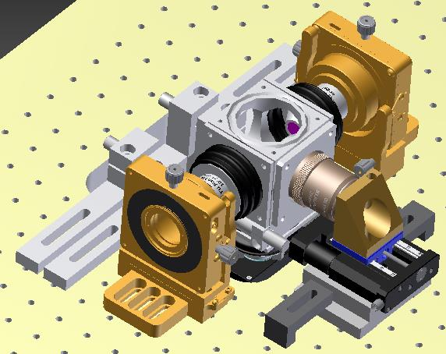
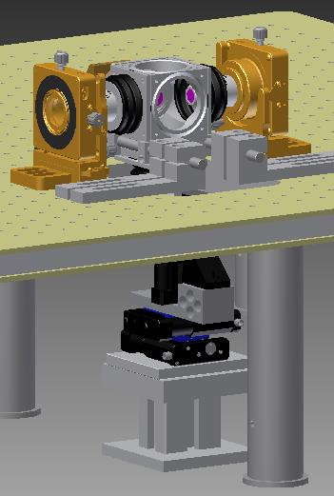
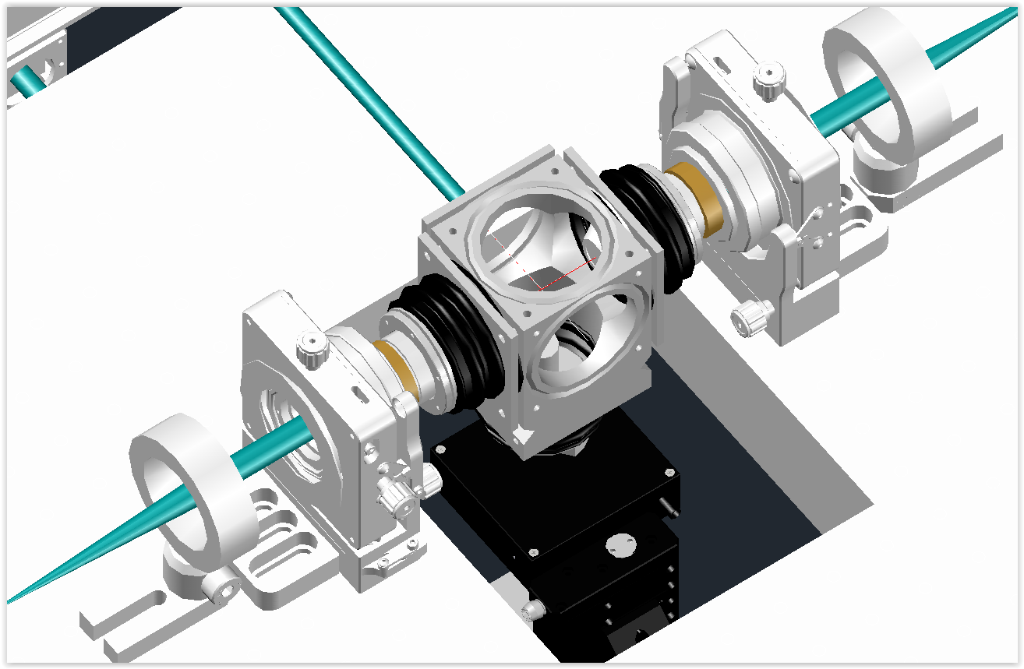

Slide 9
B

Slide 10
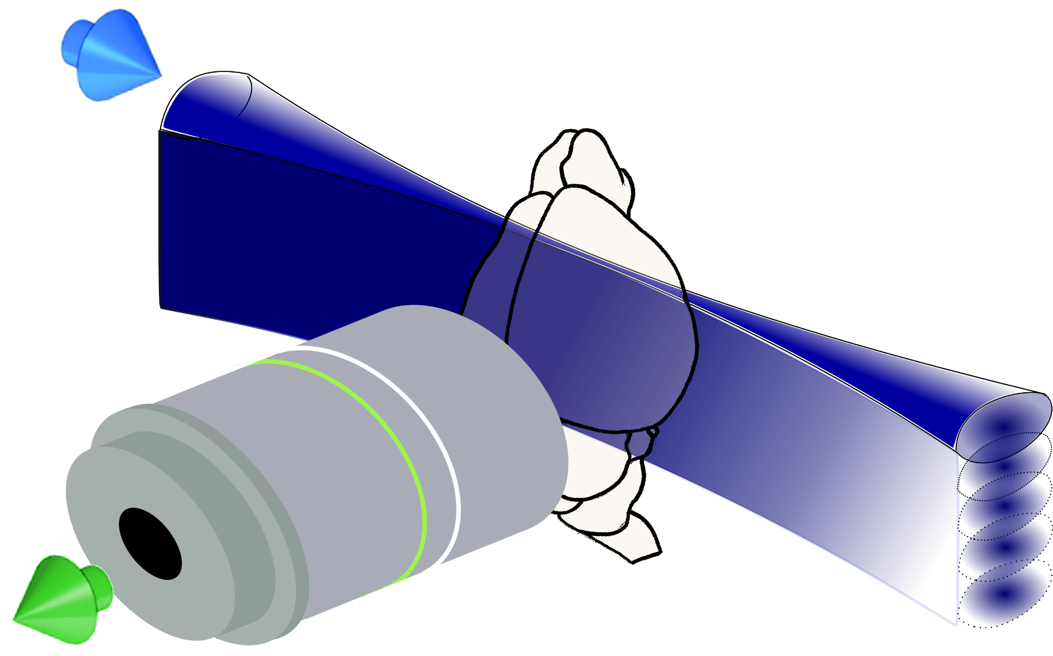

Slide 11
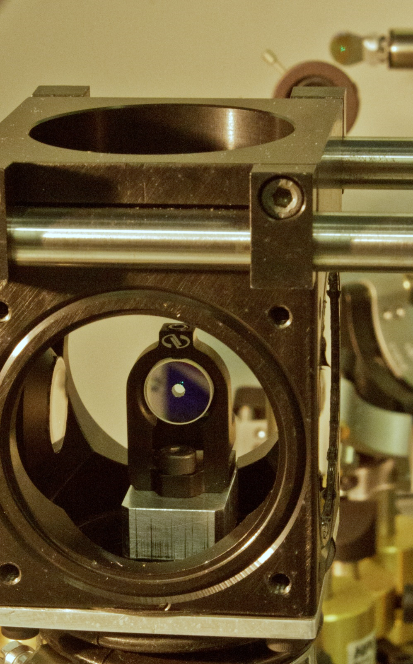
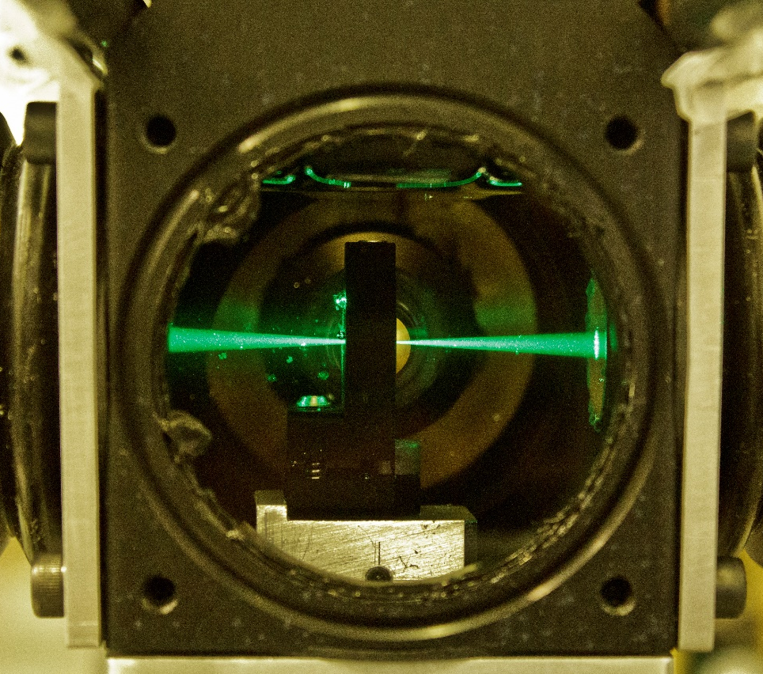
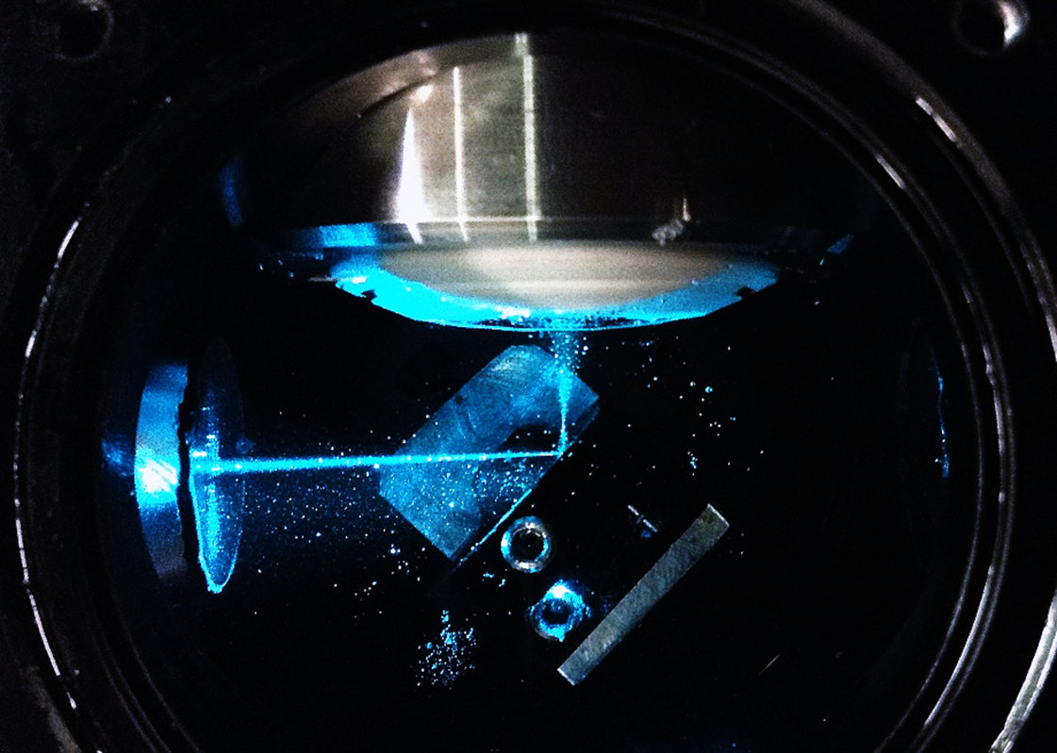
A
Camera
B
C
PBS
AD 350
AD 350
AD 200
D
AD 200
AD 200
v
AD 50
AD 100
AD 100
AD 50

Slide 12
Camera
1’ image plane
PBS
AD 350
AD 350
AD 200
AD 200
AD 200
1’ image plane
BFP
1’ image plane
BFP
BFP
galvo
v
galvo
AD 50
AD 100
AD 100
AD 50
object
plane
4f
4f

Slide 13
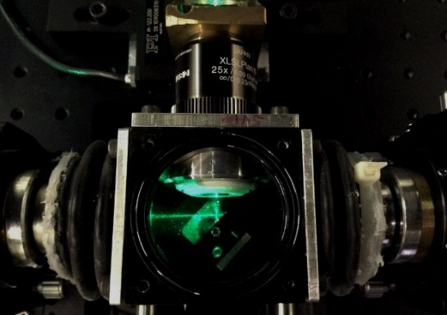

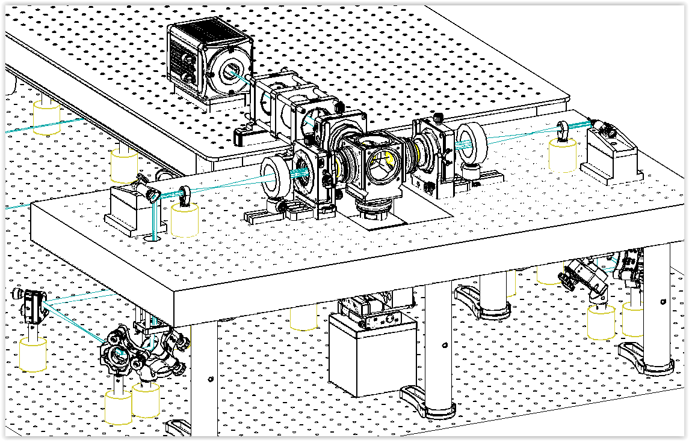
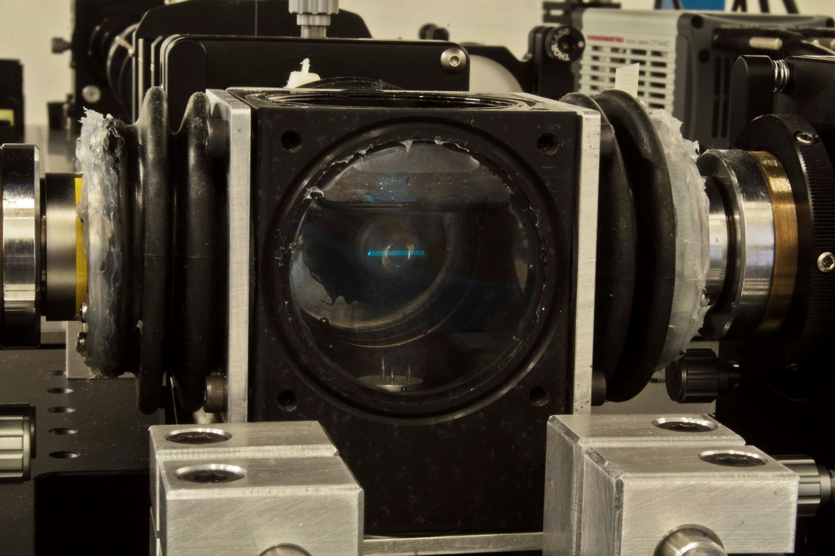
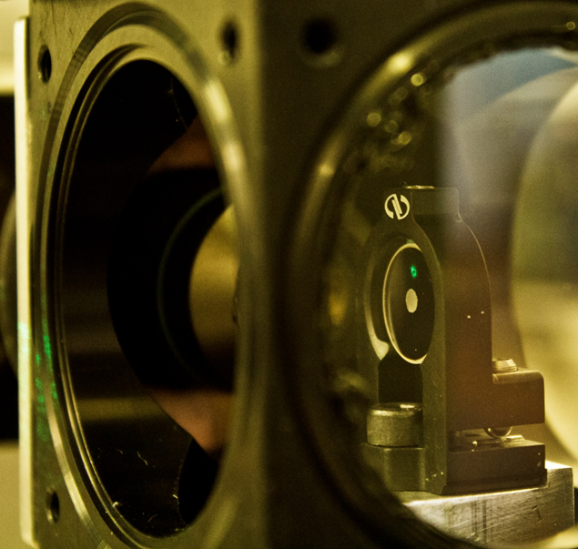

Slide 14
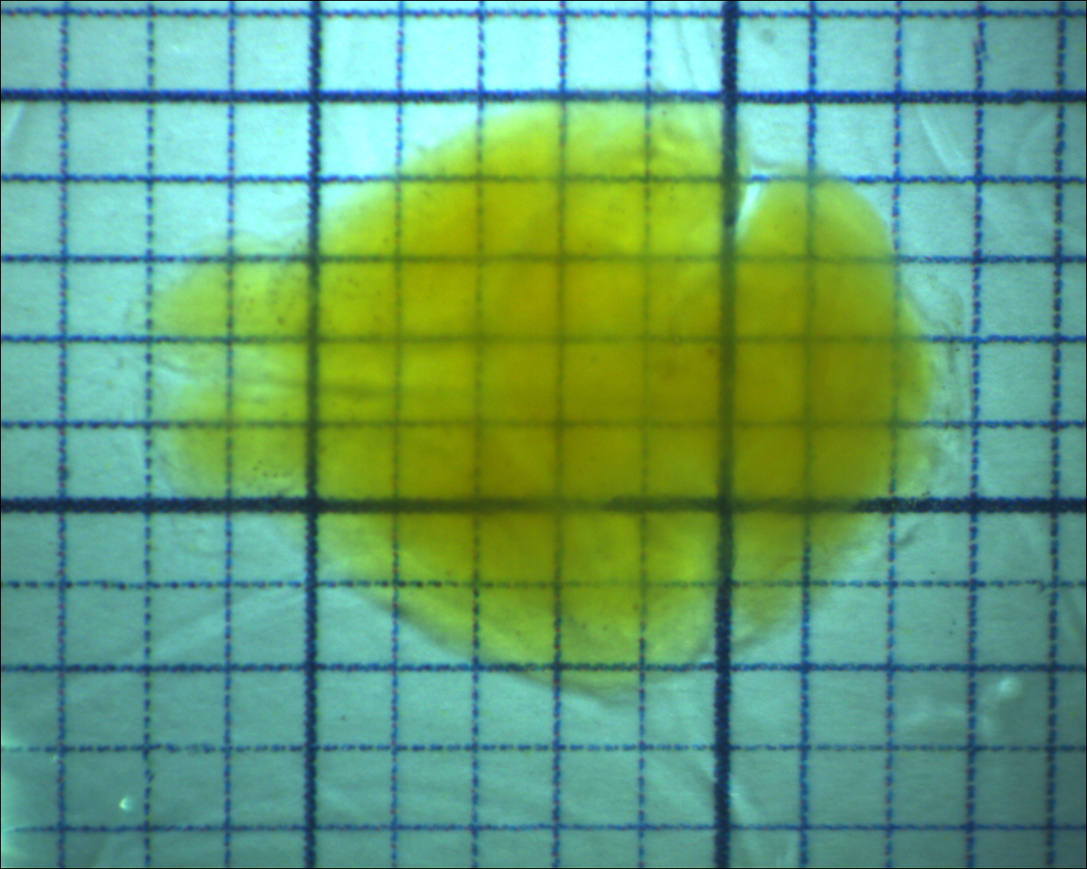

Slide 15
A
B
Tomo
Motor stages
USB
X
Y
Z
θ
Laser
Stack
Data Transfer
PC 1
USB
RS232
Laser
RS232 Hub
Laser
Laser
AOTF
Laser
RS232
Camera
Motor Stages
Galvo A
DAQ
AO
Galvo B
BNC
Ethernet
Custom Eletronics
Pulse
Amp.
Laser
Mod.
Int. BUS
AO & DO
BNC
Waveform
Generator
AOTF
DI
PC 2
BNC
Trigger output
Camera
CameraLink
DAQ controller
Lasers

Slide 16
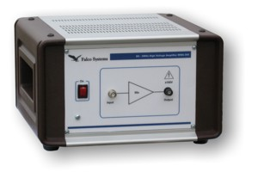
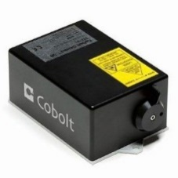
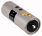
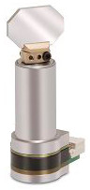
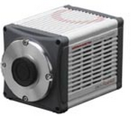
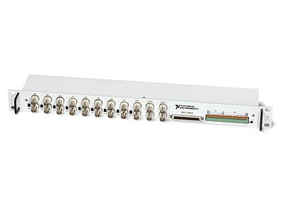
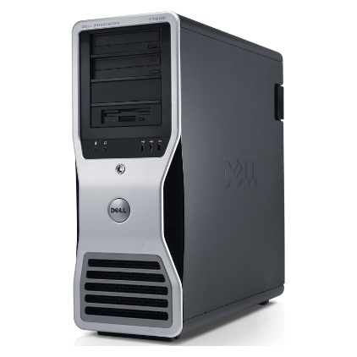
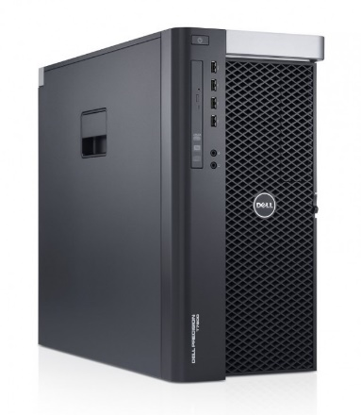
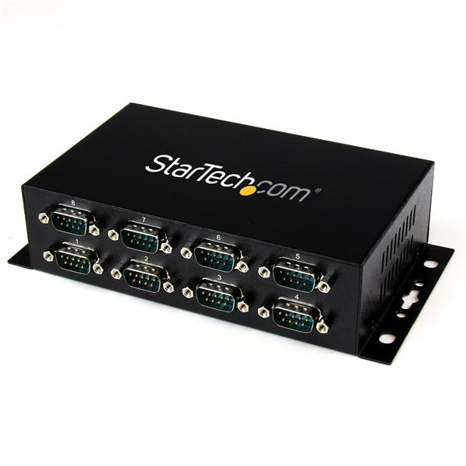
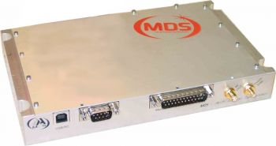
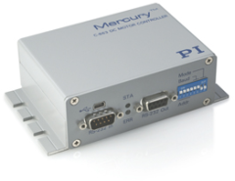

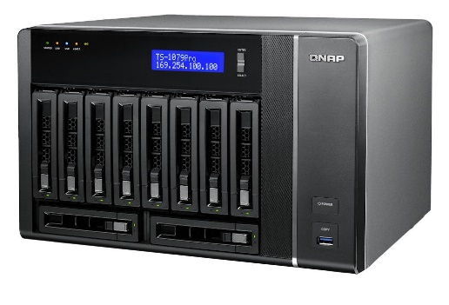
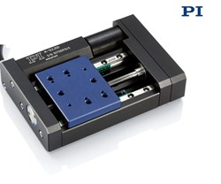
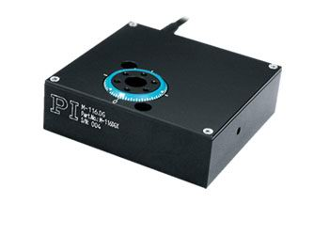
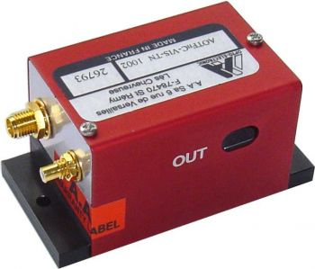
Connections
Pulse amplifier
EOM
Galvo 1
1 Gb/s ethernet
405 nm laser
10 Gb/s SFP+
Camera
DAQ
Galvo 2
445 nm laser
CameraLink
Co-axial
491 nm laser
HV co-axial
PC2
USB
RS-232 Hub
515 nm laser
RS232 Daisy Chain
PC1
RS-232
561 nm laser
RF co-axial
Internal bus
RF generator
Servo motor
Servo motor
Servo motor
Servo motor
AOTF
Supercomputing Centre
NAS
Translation x
Translation y
Translation z
Rotation stage

Slide 17
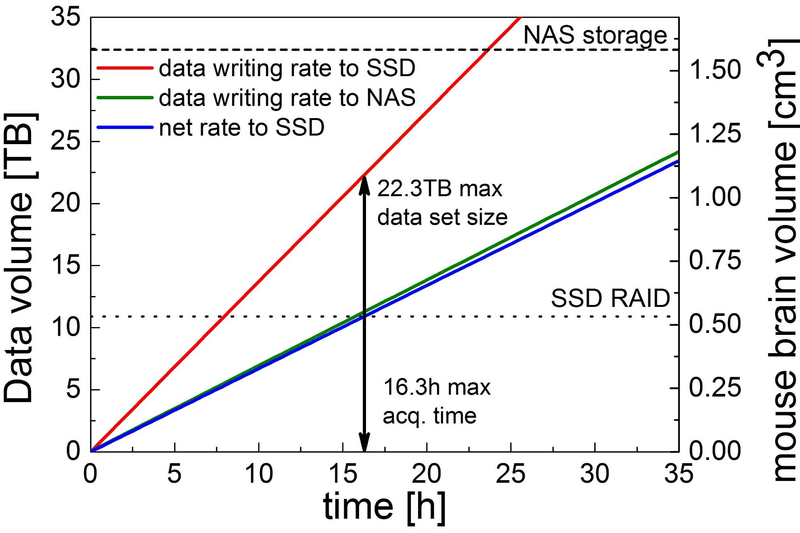
A
B
Camera
10 Gb Optical fibres
Remote repository
CINECA
CameraLink
board
10Gb network card
System
bus
Network-attached storage
32.4 TB
Raw data stream
Local SSD RAID 0
10.9TB
Data conversion stream
Transfer to remote repository
Workstation
Laboratory

Slide 18
Configure
Change hard-wired parameters (e.g. hardware ports names)
Update
Update run-time settings
(i.e. exposure time)
Main loop
Wait for user interaction and for messages from other components
Program start
Initialize
Set up hardware connections and load drivers
Terminate
Close all connections and drivers
Program end
Start
Begin grabbing images
Proceed
Grab images and decide to continue or not
Stop
Stop grabbing images

Slide 19
Tomo
Stack
Data Transfer
Camera
Motor Stages
Waveform
Generator
AOTF
(Shutter)
DAQ
Board
Laser
Modulator
Galvo
Scanners
Lasers

Slide 20
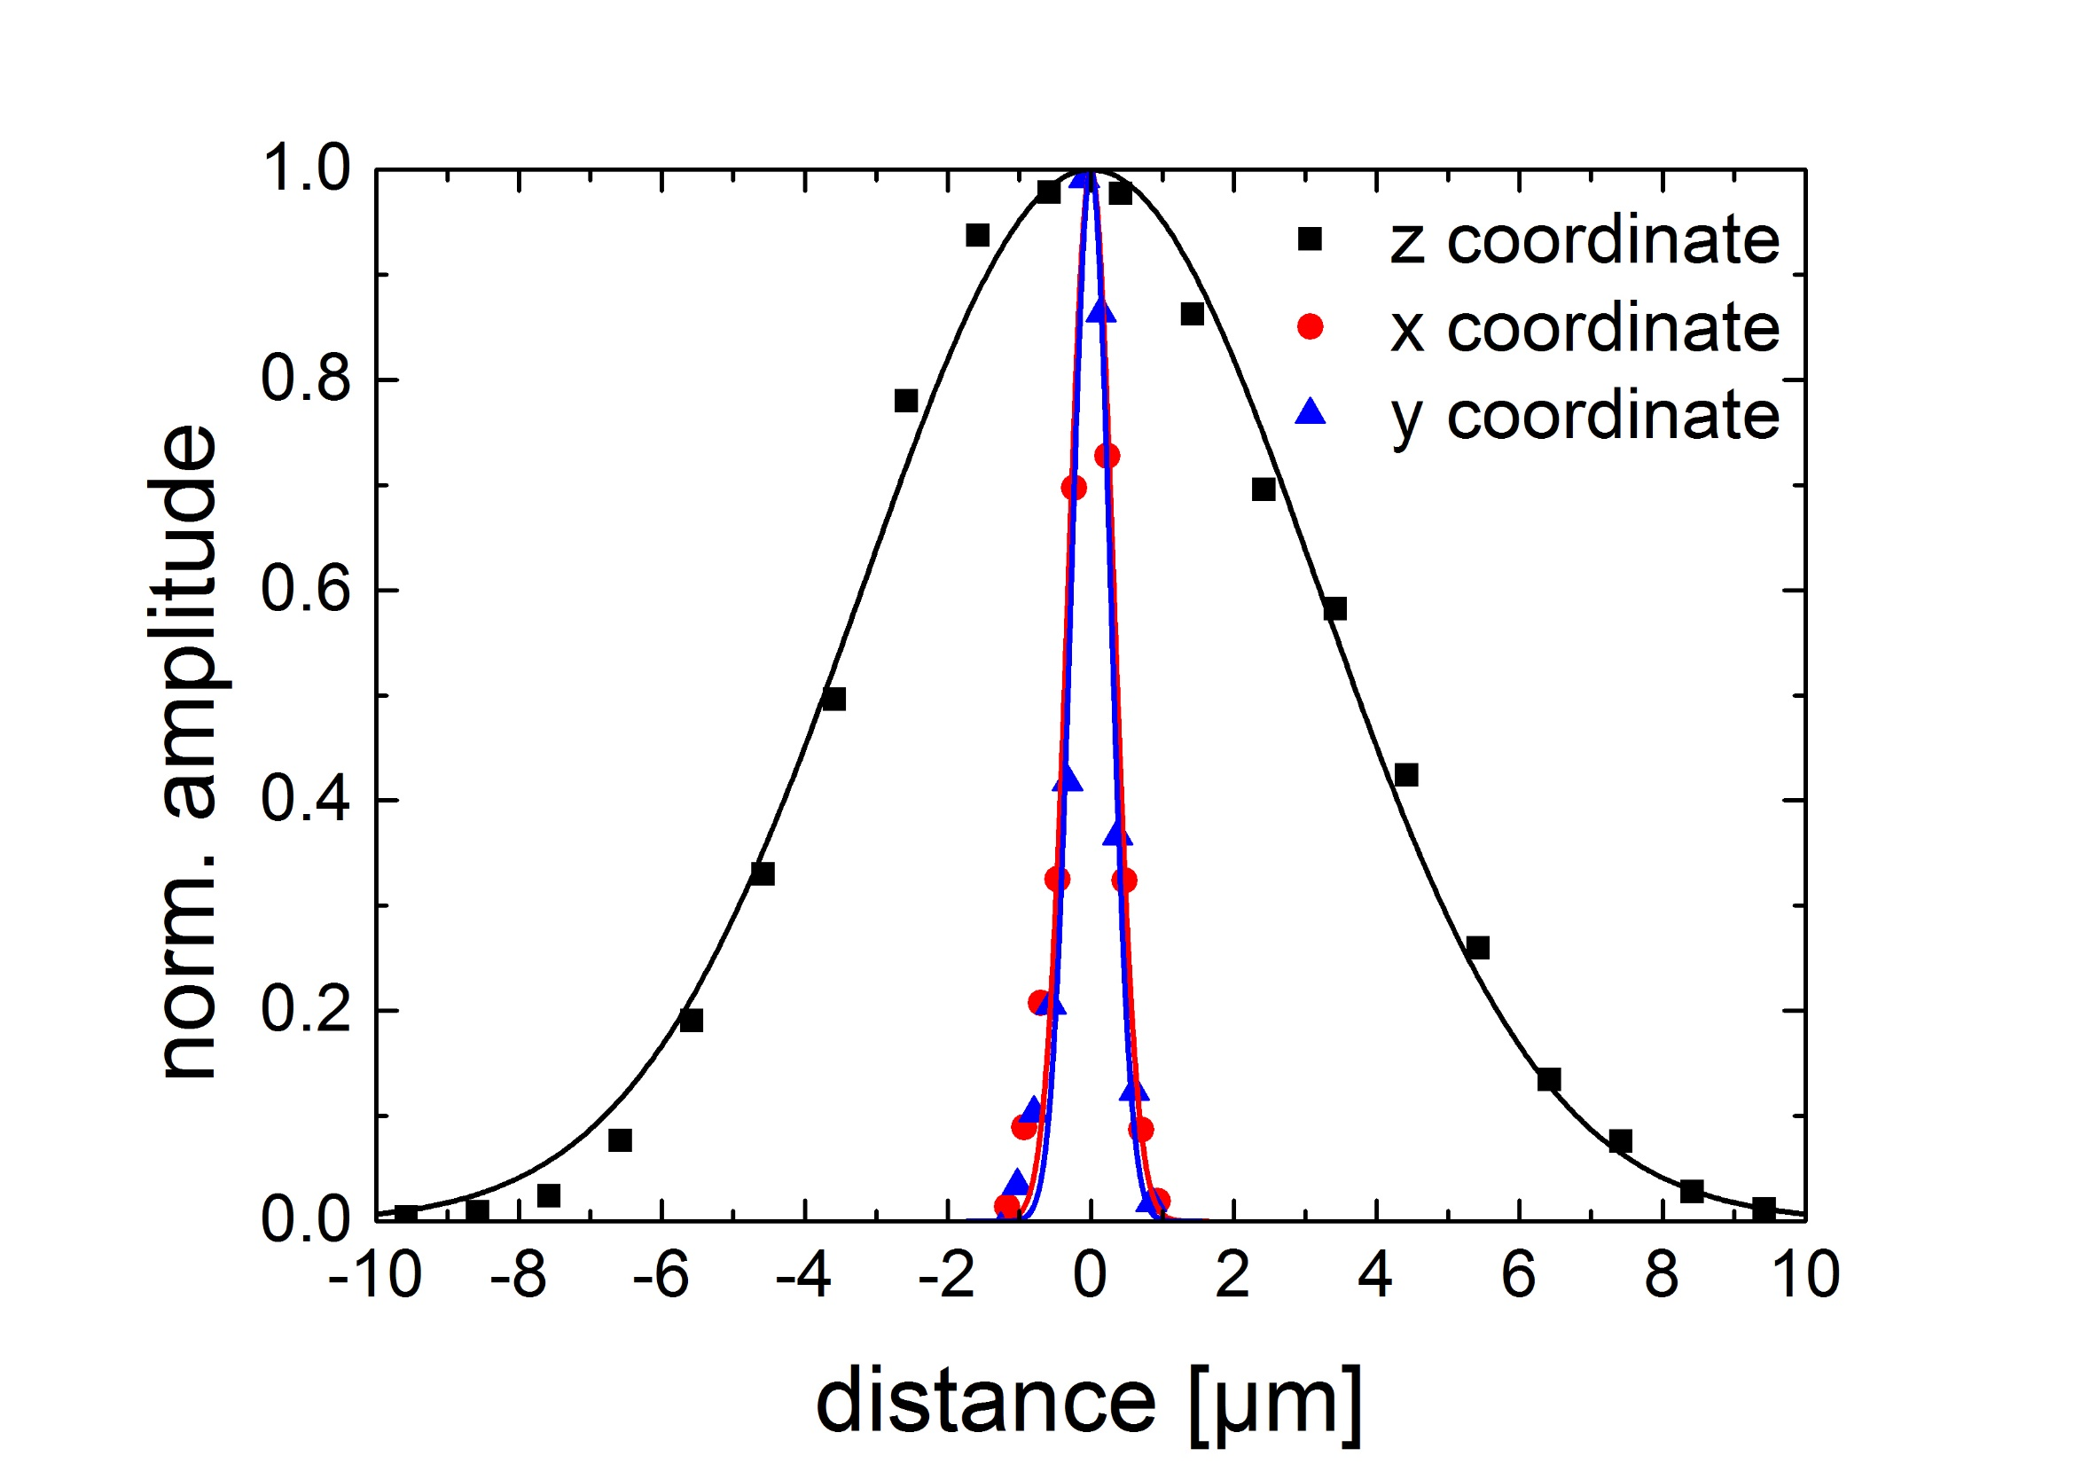
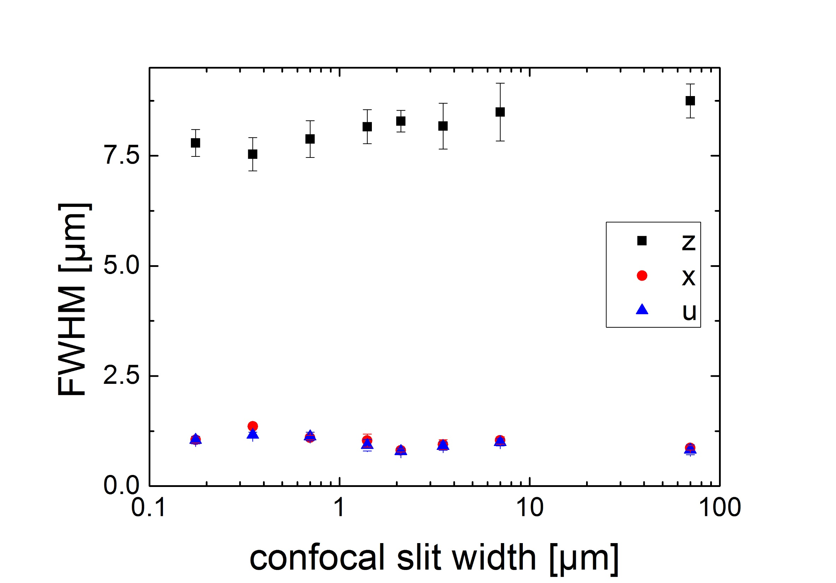
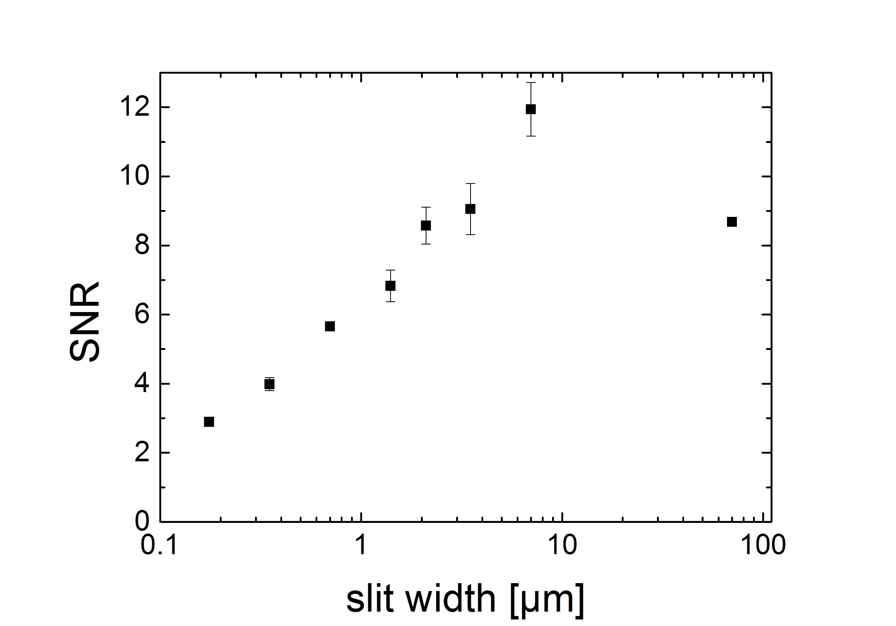
A
B
C

Slide 22
AD f=100
AD f=100
AD f=50

Slide 24
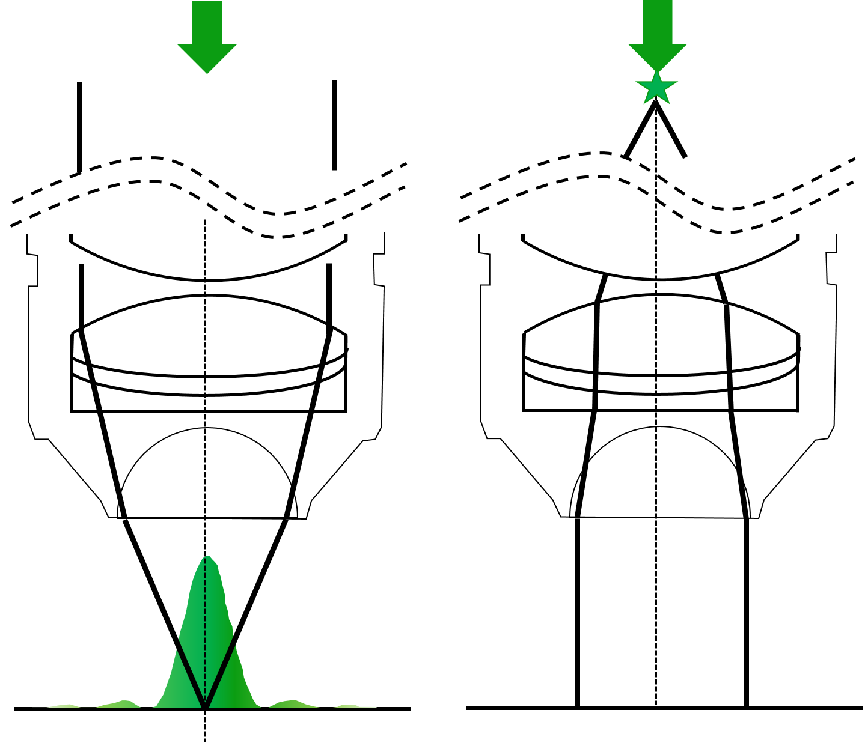
A
B
C
D

Slide 25
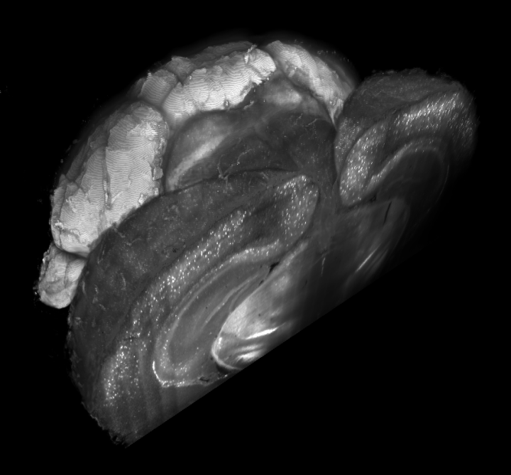
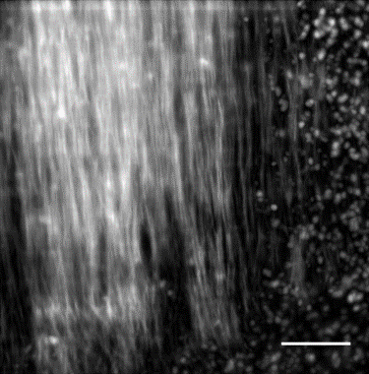
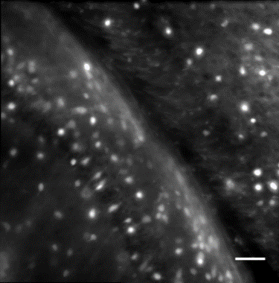
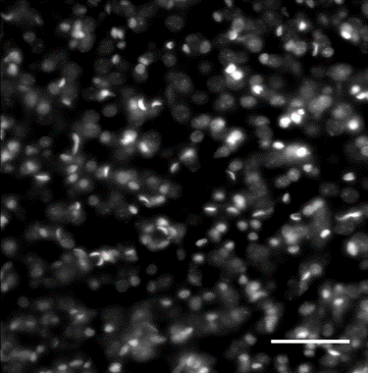

a
b
GAD
Vasc
d
PV
PI
c
PV
GAD
e
PI
f
Vasc

Slide 26




A
B
C
PV
PV
GAD
PI
D
GAD
E
PI

